Slide 1
Unit 9
Structure and Union

Slide 2
What is structure?
A structure is a collection of variables under a single name.
Arrays allow to define type of variables that can hold several data items of the same kind.
Similarly structure is another user defined data type available in C that allows to combine data items of different kinds.
A structure is a convenient way of grouping several pieces of related information together.

Slide 3
What is structure?
A structure is a convenient tool for handling a group of logically related data items.
For ex: name, roll, fee, marks, address, gender and phone are related information of a student.
To store information about a student, we would require to store the name of the student which is array of characters, roll of student which is integer type of data and so on.
These attributes of students can be grouped into a single entity, student. Here, student is known as structure which organizes different data times in a more meaningful way.

Slide 4
Defining a structure
Syntax:
struct structure_name{
data_type member_variable1;
data_type member_variable1;
data_type member_variable1;
….........
….........
data_type member_variable1;
};
Once structure_name is declared as new data type, then variables of that type can be declared as
struct structure_name structure_variable;

Slide 5
Example for structure
Let us create a structure named student that has name, roll, marks and remarks as members.
struct student{
char name[20];
int roll;
float marks;
char remarks;
};
Here, student is structure name and its members are name, roll, marks and remarks.

Slide 6
So from before example, student is new data type and various variables of type struct student can be declared as:
struct student st;
Similarly multiple variables can also be declared:
struct student st1, st2,st3;
The member variables are accessed using dot (.)operator.
Each member variable of structure has its own copy of member variables.
For ex: st1.name is member variable, name of st1 structure variable.
st2.roll is member variable, roll of st2 structure variable.
We can also write as:
struct student{
char name[20];
int roll;
float marks;
char remarks;
}st1, st2;

Slide 7
DIY
Create structure date which has property day, year and month.
Create structure book which has property …, .... ,....,....
Create structure employee which has property …, .... ,....,....
Create structure account which has property …, .... ,....,....
Create structure department store which has property …, .... ,....,....
YOU HAVE 5 MINUTES!!!!

Slide 8
examples
struct date { int day; int month; int year; } | struct book{ char title[25]; char author[20]; int pages; float price; }b1,b2; | struct epmployee{ int emp_id; char emp_name[20]; int age; char gender; float salary; }b1,b2; | struct account{ int acc_no; char acc_type[20]; float balance; };

Slide 9
Structure Initialization
The values to be initialized must appear in order as in the definition of structure within braces and separated by commas.
C does not allow the initialization of individual structure members within its definition.
struct student{
char name[20];
int roll;
float marks;
};
A variable of this type can be initialized during its declaration as shown below
struct student st={“Ram”, 12, 55.4};
This line is similar to
struct student st;
st.name=“Ram”;
st.roll=12;
st.marks=55.4;

Slide 10
How Structure Elements Are Stored
The elements of a structure are always stored in contiguous memory location.
A structure variable reserves number of bytes equal to sum of bytes needed to each of its members.
For ex: struct student{
int roll;
float marks;
char remarks;
}st;
Here, structure student’s variables st takes 7 bytes in memory as its member variable roll needs 2bytes, marks needs 4 bytes and remarks needs 1 byte.

Slide 11
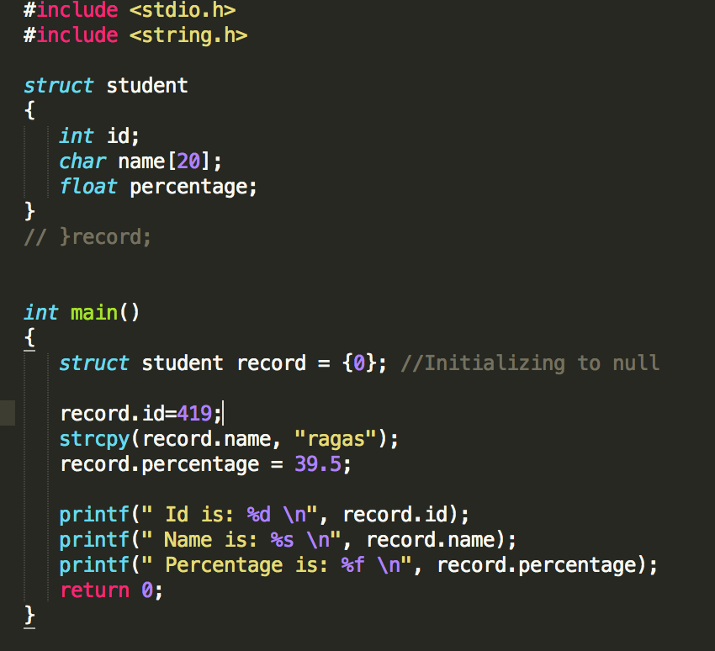
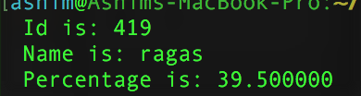

OUTPUT

Slide 12
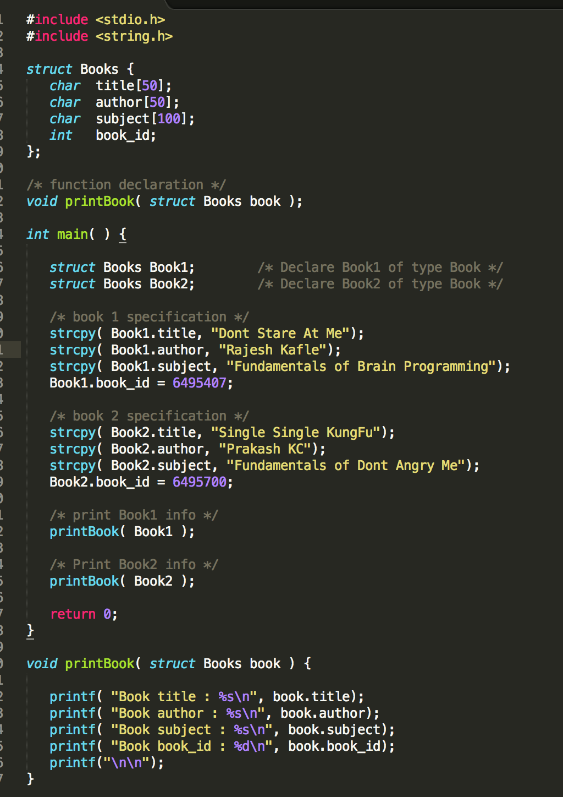
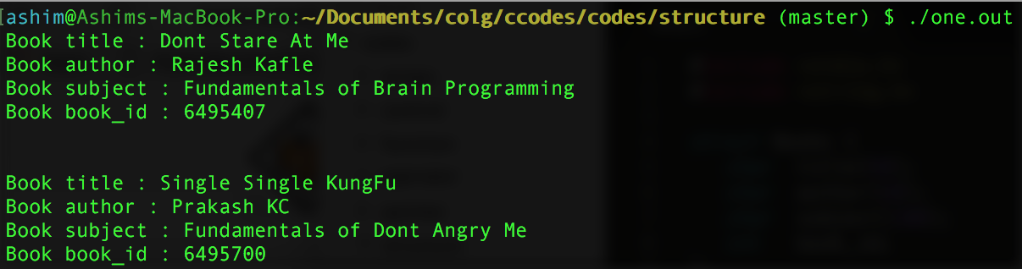
Output

Slide 13
DIY
Create a structure named student that has name, roll, marks and remarks as members. WAP to read and display data entered by the user.
Create a structure named employee as members. WAP to read and display data entered by the user.

Slide 14
Array Of Structure
In our previous structure examples, if we want to keep record of 50 students, we have to make 50 structure variables like st1,st2….st50. (WORST Technique)
To tackle this we can use array of structure to store records of 50 students.
An array of structure can be declared in two ways as illustrated below
struct Employee{ char name[20]; int empID; float salary; }emp[10]; | struct Employee{ char name[20]; int empID; float salary; }; struct Employee emp[10];
Here emp is an array of 10 Employee structures. Each element of the array emp will contain the structure of the type Employee.

Slide 15
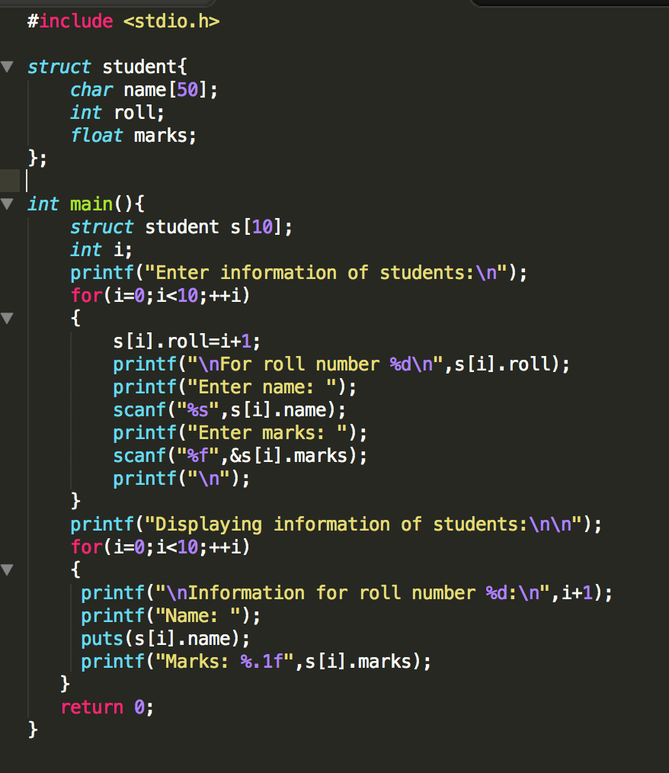
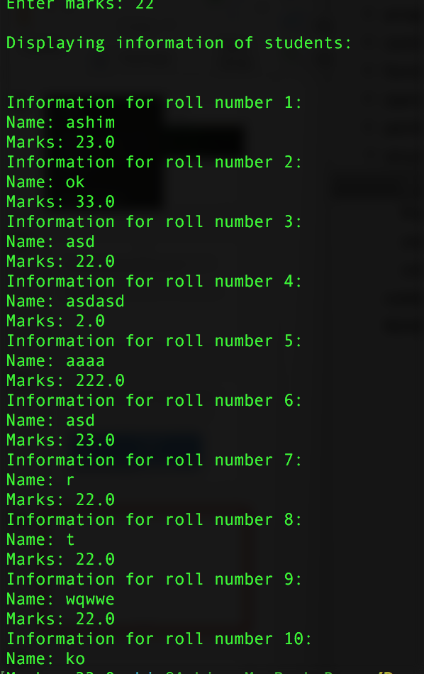

Slide 16
Initializing array of structure
struct student{
char name[50];
int roll;
float marks;
};
struct student stu[5]={
“Ram”, 200,150.5;
“Rahim”, 220,250.5;
“kasprowich”, 210,250.4;
“Smith”, 300,350.1;
“Steven”, 400,120.5;
}

Slide 17
Structure within structure (Nested Structure)
Structure written inside another structure is called as nesting of two structures.
Nested Structures are allowed in C Programming Language.
We can write one Structure inside another structure as member of another structure.
Ex:
struct date { int date; int month; int year; }; | struct Employee { char ename[20]; int ssn; float salary; struct date doj; }emp1;

Slide 18
Person
Members of Structures
person
struct date{ int day; int month; int year; }; | struct person{ char name[20]; int id; struct date dateOfBirthday; float salary; }p;
Members of Structures
dateOfBirth
Name
Day
DateOfBirth
Month
Id
Year
Salary
The members within structure date can be accessed as: | The members within person structure are accessed as:
p.dateOfBirthday.day p.dateOfBirthday.month p.dateOfBirthday.year | p.Name p.Id p.salary

Slide 19
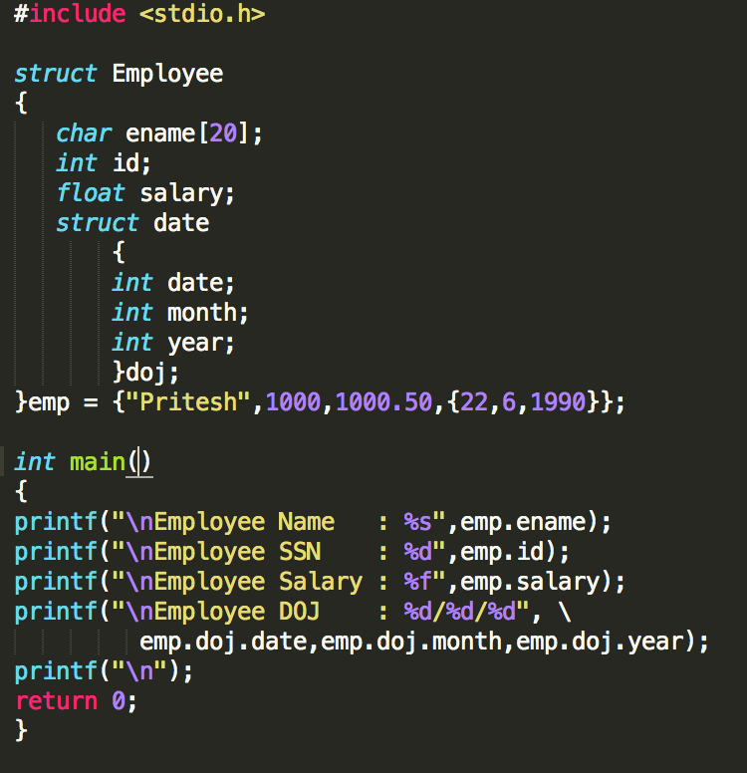
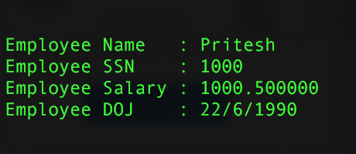
Output

Slide 20
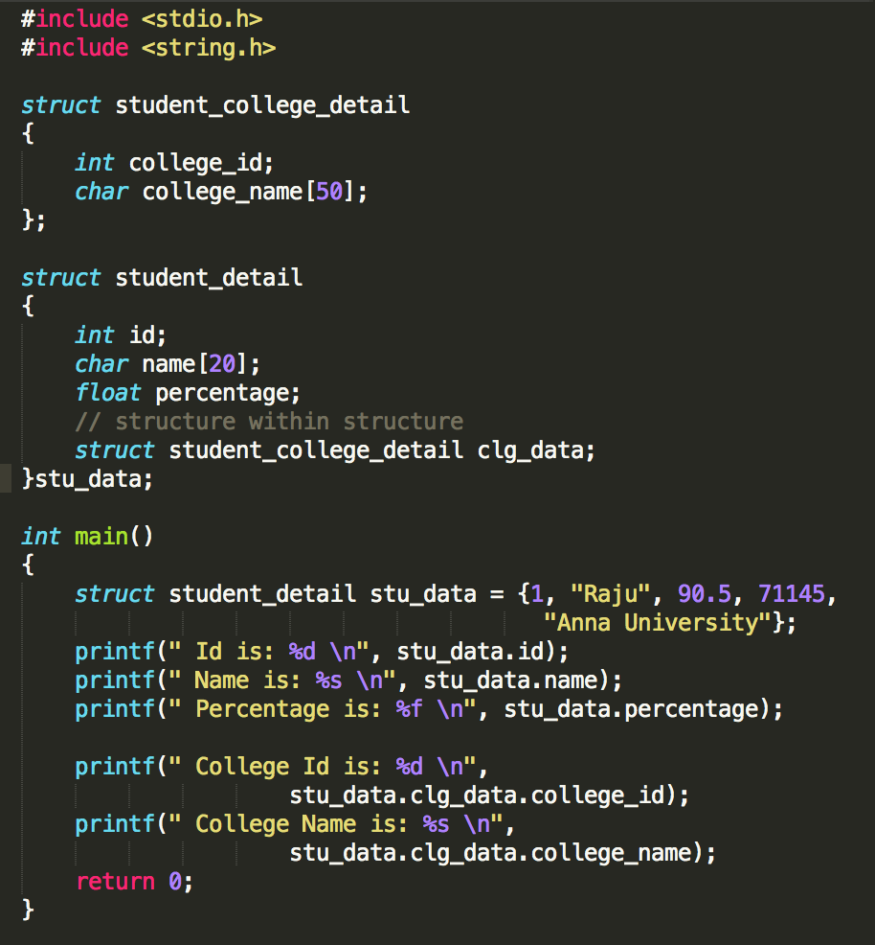
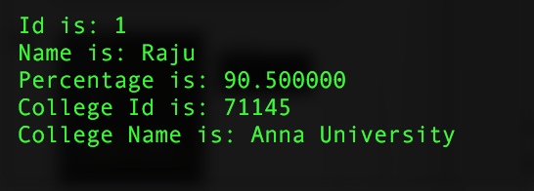
OUTPUT

Slide 21
Pointer to structure
Pointers can be used also with structure.
To store address of a structure type variable, we can define a structure type pointer variable as normal way.
Let us consider a structure book that has members name, page and price.
struct book{ char name[10]; int page; float price; }
struct book b; // b is a structure variable
struct book *bptr; // b is a pointer variable of structure type
The declaration for a pointer to structure doesn’t allocate any
memory for a structure but allocates only for pointer.

Slide 22
To use structure members through pointer bptr, memory must be allocated for a structure by using function malloc() or by adding declaration and assignment as given below.
bptr=&b; //here the base address of b can be assigned to bptr pointer.
An individual structure member can be accessed in terms of its corresponding pointer variable by writing
ptr_variable -> member;
Here -> is called arrow operator and there must be pointer to the structure on the left side of this operator.
i.e. Now the members name, pages and price of book can be accessed as
b.name; OR bptr-> name OR (*bptr).name
b.page; OR bptr-> page OR (*bptr). page
b.price; OR bptr-> price OR (*bptr). price

Slide 23
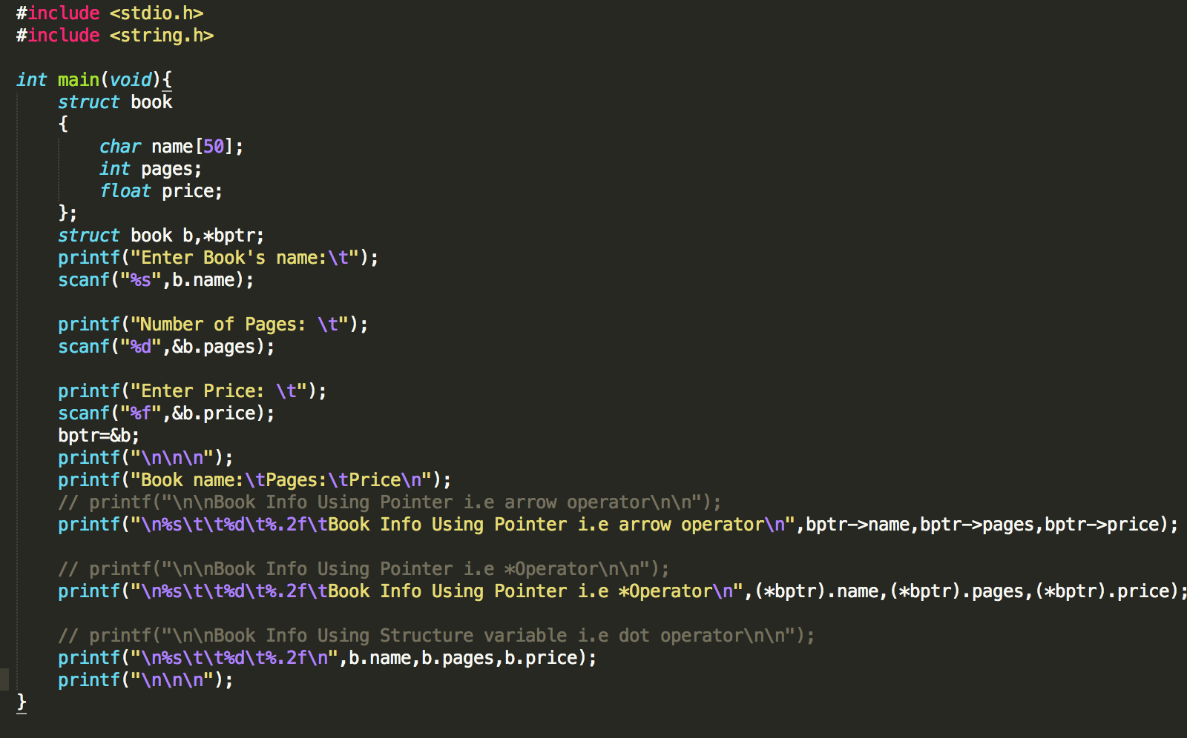
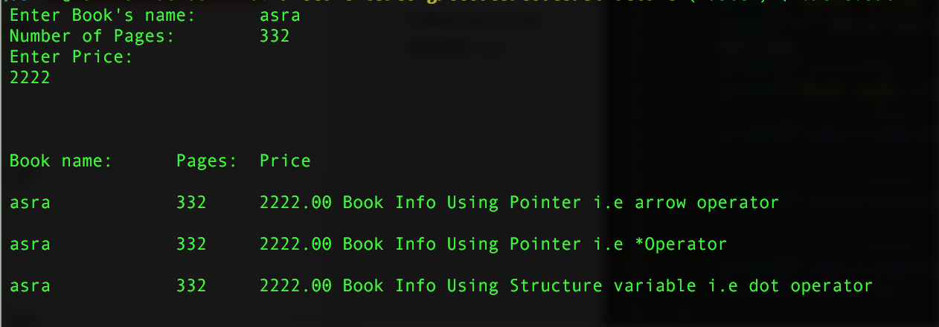

Slide 33
References:
http://www.studytonight.com/c/structures-in-c.php
http://www.tutorialspoint.com/cprogramming/c_structures.htm
http://www.javakode.com/c-programming/c-structures/
http://c.learncodethehardway.org/book/ex16.html

